Slide 1
CSS430 Process Synchronization Textbook Chapter 6
Instructor: Stephen G. Dame
e-mail: sdame@uw.edu
These slides were adapted from the OSC textbook slides (Silberschatz, Galvin, and Gagne), Professor Munehiro Fukuda and the instructor’s class materials.

Slide 2
WKP 17
“Programming is the process of converting caffeine into error messages” - Unknown

Slide 3
Learning Objectives
Introduction to the Critical-Section Problem
Discuss HW & SW solutions to C-S Problem
Atomic Transactions and mechanisms
Java Synchronization techniques:
Mutex
Semaphores
Monitors

Slide 4
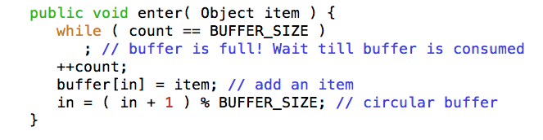
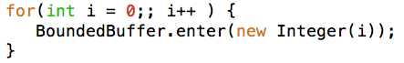
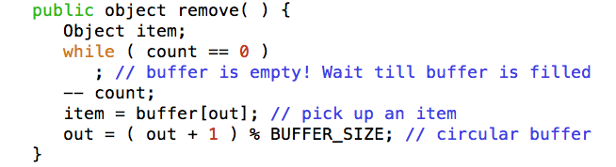
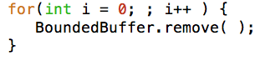
Revisiting Bounded Buffer
Producer Process
Consumer Process
Buffer[0] [1] [2] [3] [4]
Let’s Dissect the problem!
I
I
I
out=1
in=4

Slide 5
Race Condition
++count:
reg1 = mem[count];
reg1 = reg1 + 1;
mem[count] = reg1;
- count:
reg2 = mem[count];
reg2 = reg2 – 1;
mem[count] = reg2;
Producer: reg1 = mem[count]; {reg1=5}
Producer: reg1 = reg1 + 1; {reg1=6}
Consumer: reg2 = mem[count]; {reg2=5}
Consumer: reg2 = reg2 – 1; {reg2=4}
Producer: mem[count] = reg1; {count=6}
Consumer: mem[count] = reg2; {count=4}
The outcome of concurrent thread execution depends on the particular order in which the access takes place → race condition!

Slide 6
The Critical Section (“CS”)
The critical section is a block of code in which no two processes can be executing their instructions at the same time.
while (true) {
entry section
critical section
exit section
remainder section
}

Slide 7
Critical Section (3) Requirements
When entering CS
Mutual Exclusion. If process P_{i} is executing in its critical section(CS), then no other processes can be executing in their corresponding critical sections.
Progress. If no process is executing in its CS, and there exist some processes that wish to enter their CS, then the selection of the processes that will enter the CS next cannot be postponed indefinitely.
Bounded Waiting. A bound must exist on the number of times that other processes are allowed to enter their CS after a process has made a request to enter its CS and before that request is granted.
Bounded times
Pick up a process to enter
Critical Section
only one process
When exiting from CS

Slide 8
Peterson’s Solution (Algorithm)
P_{i}, i=0
P_{j}, j=1
int turn; // shared var
boolean flag[2]; // shared var
while (true) {
flag[i] = true;
turn = j;
while(flag[j] && turn == j);
critical section
flag[i] = false;
remainder section
}
Must demonstrate:
Mutual Exclusion is preserved.
Progress requirement is satisfied.
Bounded Waiting requirement is met
Peterson's algorithm (solution)
G.L. Peterson White Paper

Slide 9
Mutual Exclusion Class

Slide 10
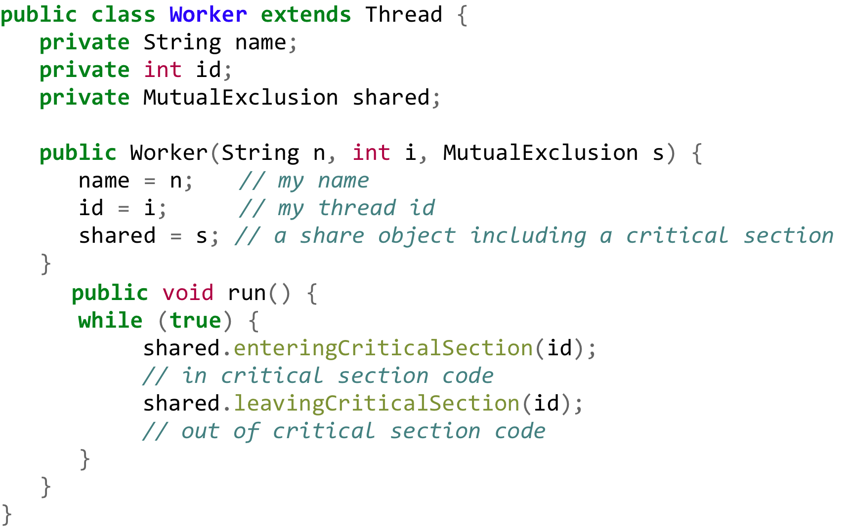
Worker Thread

Slide 11
Test Algorithm (Algorithm Factory)

Slide 12
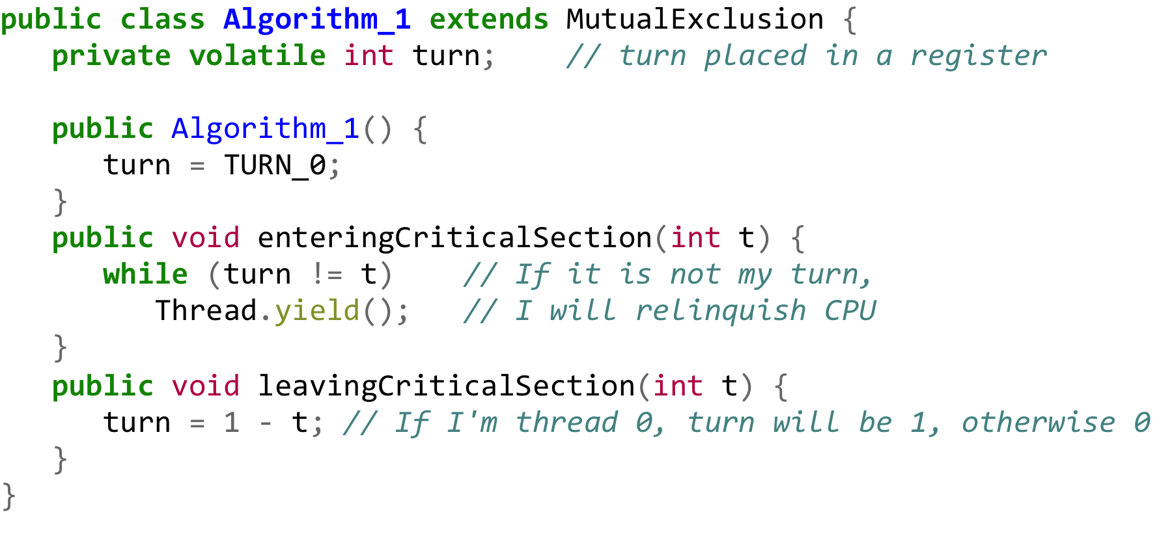
Algorithm 1 (yielding by turn)
Violates CS rule #1 – mutual exclusion
Both threads 0 and 1 cannot be in CS at same time.

Slide 13
Algorithm 2 (flag I’m using…)
Violates CS rule #2, #3 – progress + bounded waiting
Thread 0 sets flag[0] true.
A context switch occurs.
Thread 1 sets flag[1].
Thread 1 finds out flag[0] is true, and waits for Thread 0.
A context switch occurs.
Thread 0 finds out flag[1] is true, and waits for Thread 1.

Slide 14
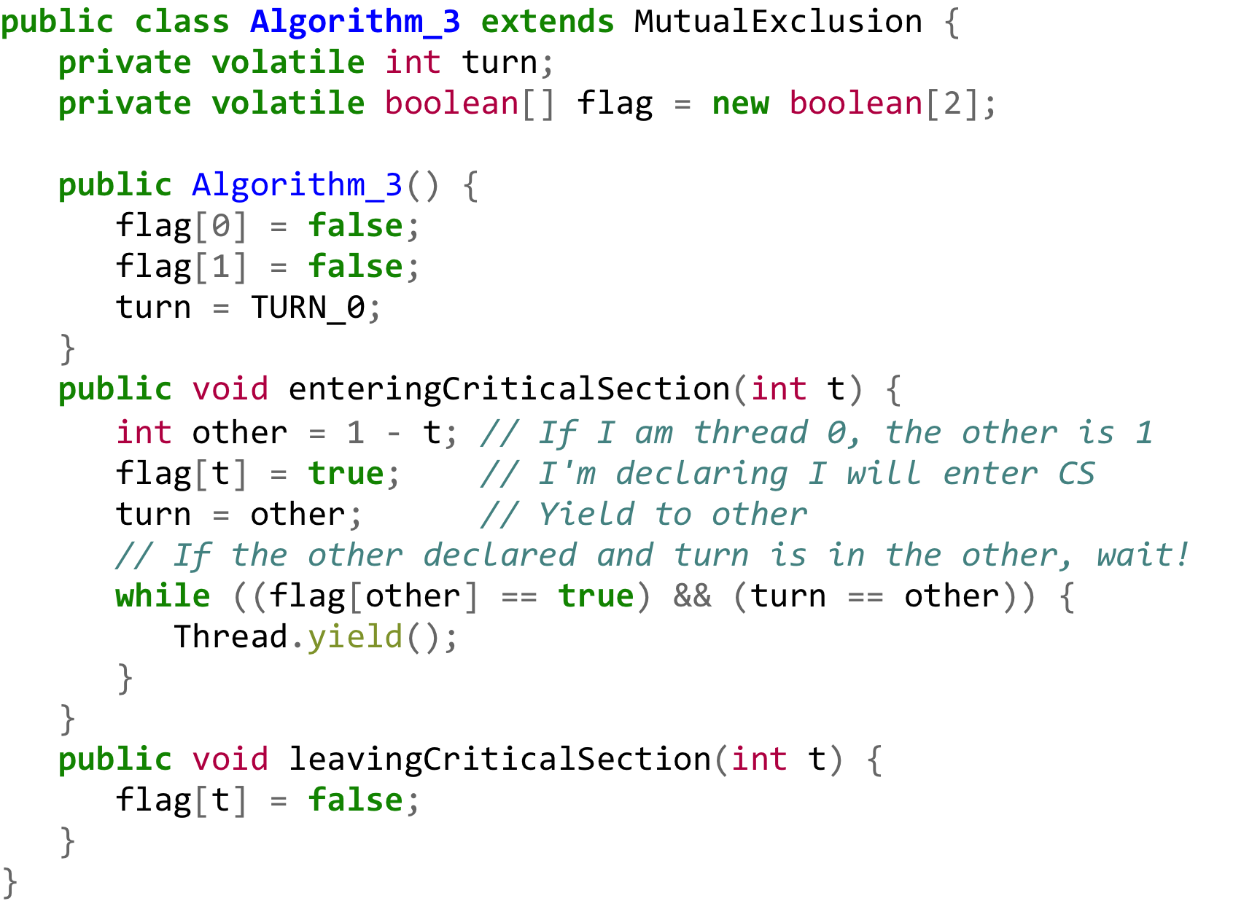
Algorithm 3 (Mixed of 1 and 2) (Peterson’s Solution)
Complies with all three CS rules–
Even in case both threads declared, will enter CS in an orderly manner
Turn eventually points to either thread A or B!

Slide 15
No Guarantees!
There no guarantees that Peterson’s solution will work correctly on modern computer architectures due to complex load and store instructions

Slide 16
Discussion 1
What is the definition of atomicity, and where does it apply?
What is the meaning of busy waiting? What is an alternative to busy waiting?
Fill out the following table with your analysis of the different CS methods:
 | Advantages | Disadvantages | Implementation (HW, OS, or Language)
TestandSet, Swap
Semaphore
Monitor

Slide 17
Synchronization
Software solutions:
Algorithm 3 (Peterson’s Solution) works only for a pair of threads. How about a mutual execution (n > 2) threads?
Lamport’s Algorithm (See Appendix).
Interrupt Masking:
Disables even time interrupts, thus not allowing preemption.
Malicious user program may hog CPU forever.
Operating systems using this technique are not broadly scalable
Hardware solutions:
Modern machines provide special atomic hardware instructions
Many systems provide hardware support for critical section code
Atomic = non-interruptible sequence of instructions
Test-and-set (or read-modify-write)
Swap contents of two memory words

Slide 18
Critical Section (“CS”) Locks
while (true) {
acquire lock
critical section
release lock
remainder section
}

Slide 19
Hardware Data Simulator

Slide 20
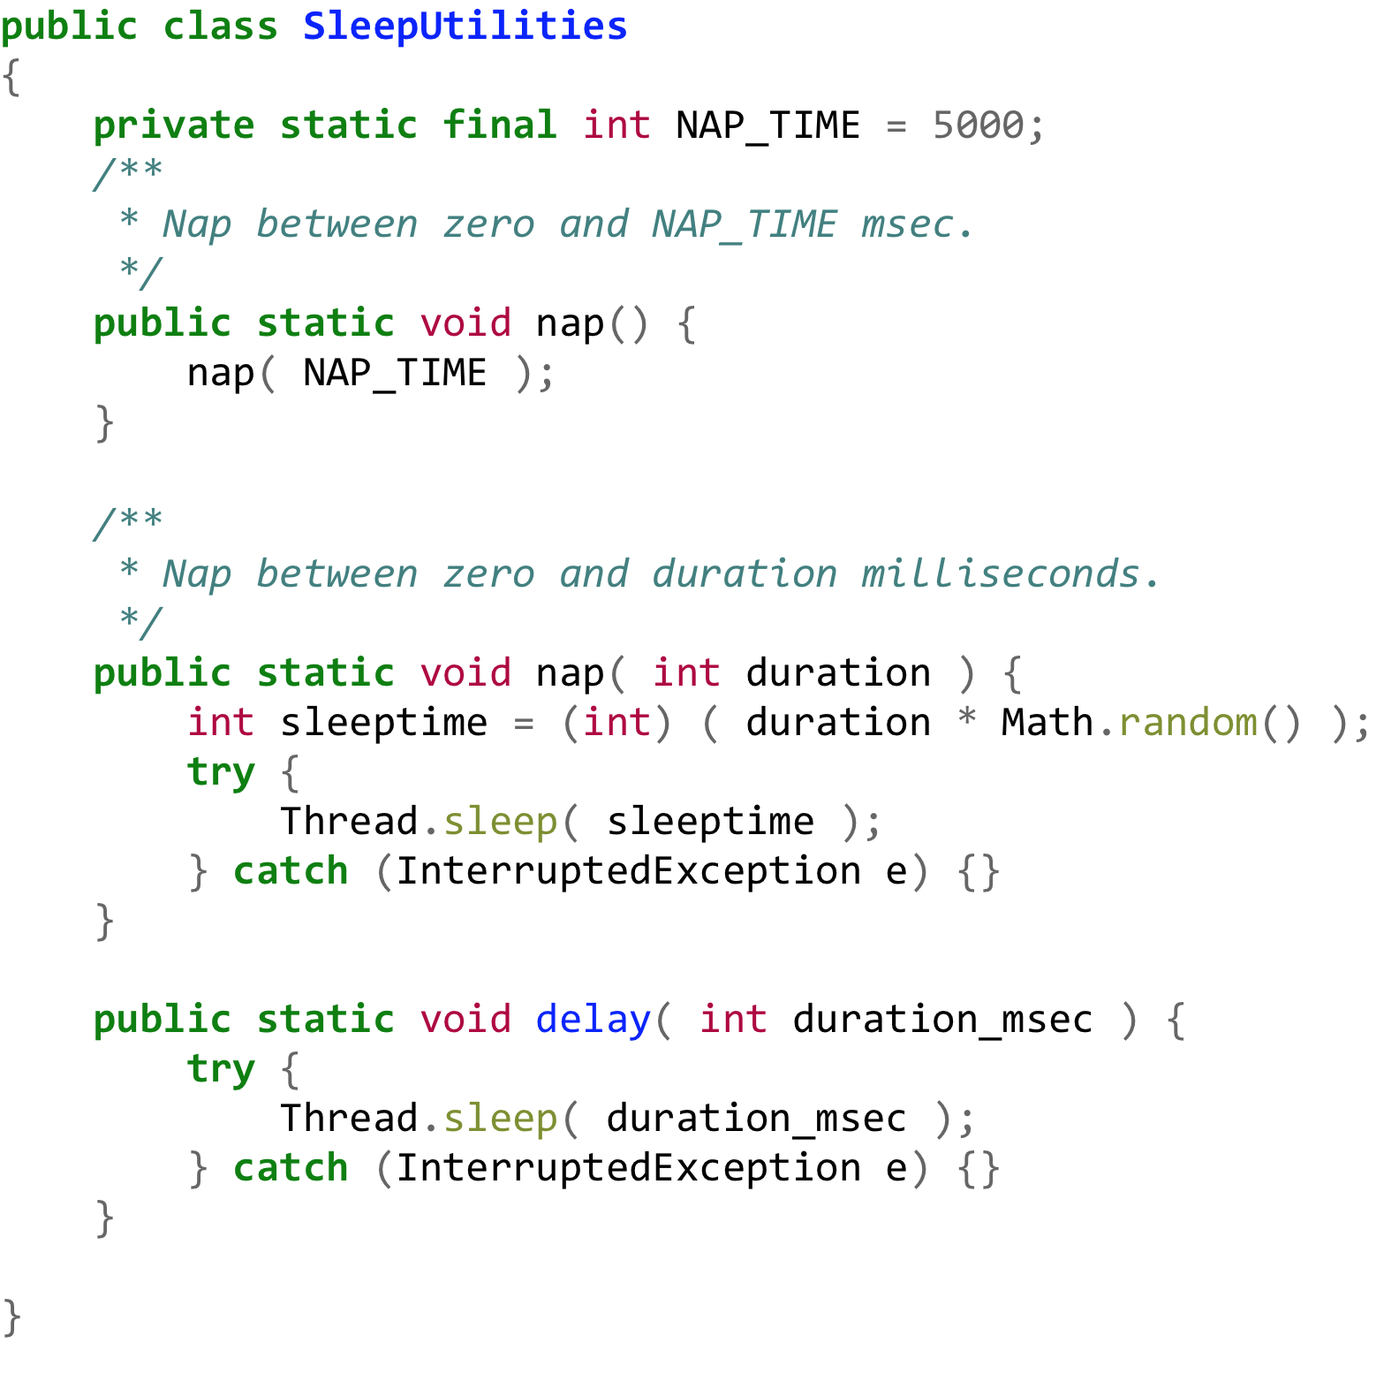
Sleep Utilities

Slide 21
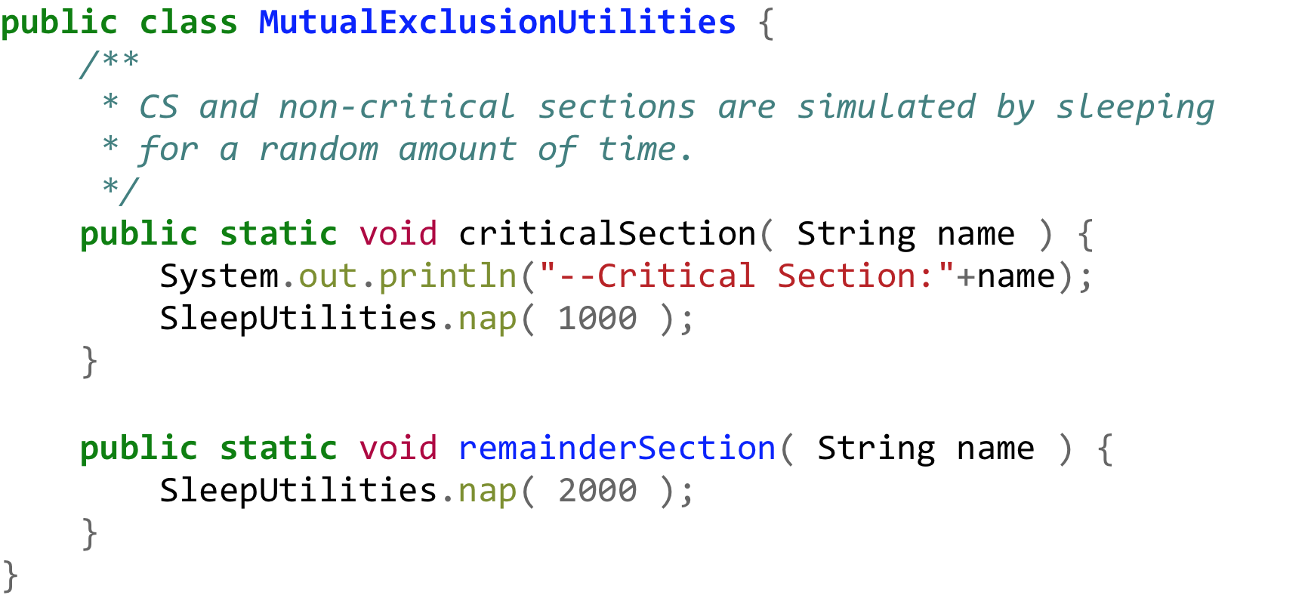
Mutual Exclusion

Slide 22
Worker Thread – Test and Set

Slide 23
H/W Algorithm → Test and Set

Slide 24
Test and Set Factory

Slide 25

Run!
Test and Set

Slide 26
H/W Algorithm → Swap

Slide 27
Worker Thread - Swap

Slide 28
Swap Factory

Slide 29
Run!
Swap

Slide 30
Semaphore
Synchronization tool that does not require busy waiting at a user level
Semaphore S – integer variable
Two standard operations modify S: acquire() and release()
Originally called P() and V() [Dutch P proberen, meaning “to test ”) and V (from verhogen, meaning “to increment”]
Less complicated (AND implemented by import java.util.concurrent.*)
Can only be accessed via two indivisible (atomic) operations
acquire( ) {
while value <= 0
; // no-op
value--;
}
release( ) {
value++;
wakeup( );
}
P
V
P
V
P
V

Slide 31
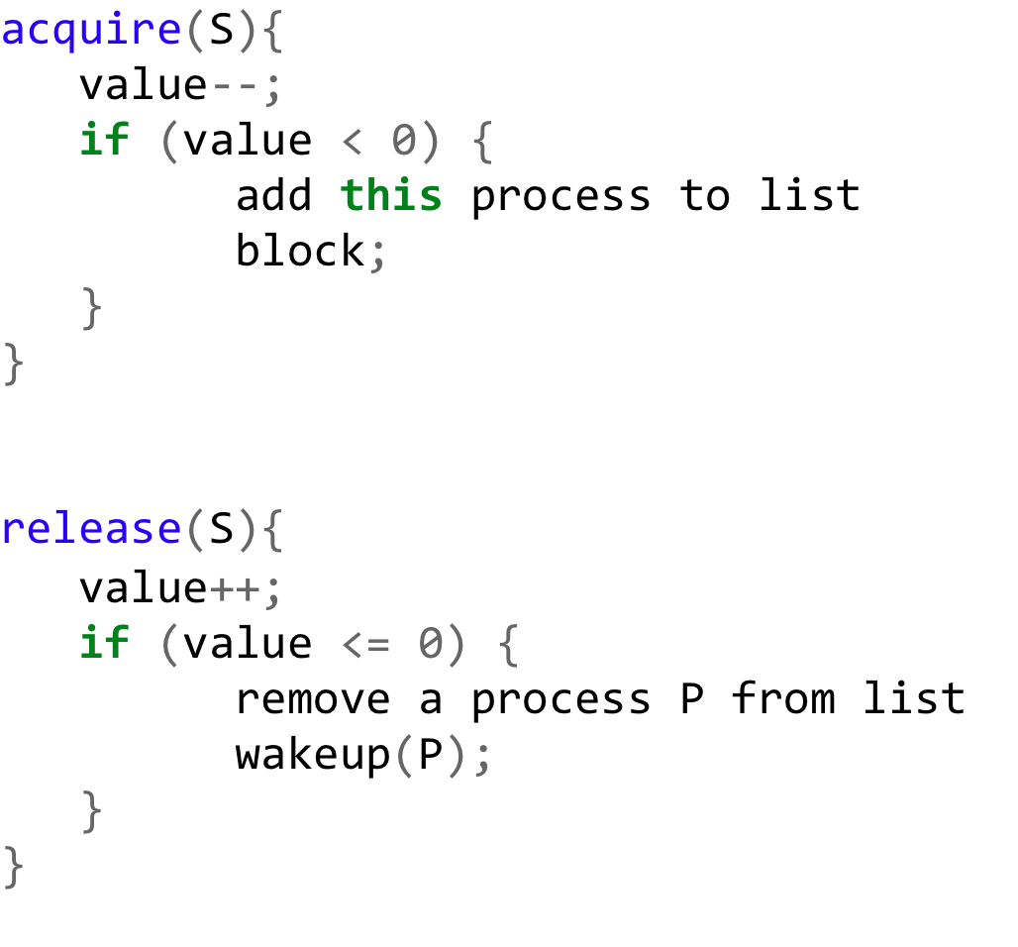
Semaphore Eliminating Busy-Waiting
Waiting List
Bee4
Bee2
Bee0
P
V
Bee3
Bee1
Waiting List
Bee4
Wake one up
Bee2
Bee0
P
V
Bee3
Bee1

Slide 32
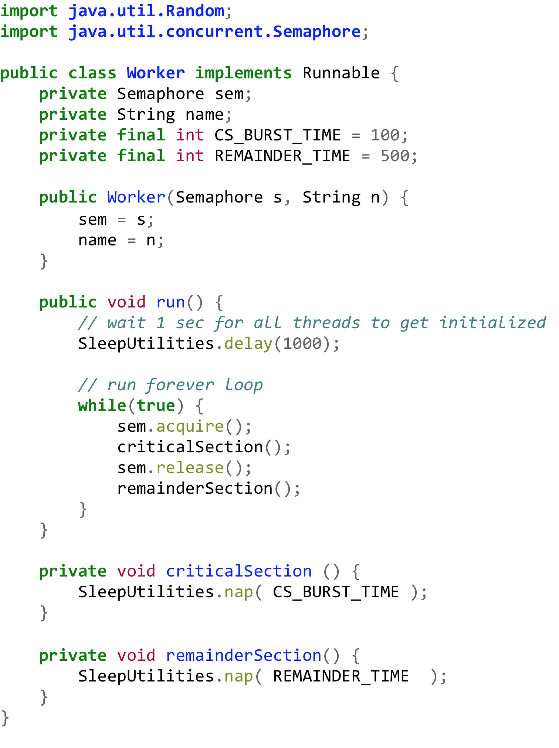
Semaphore Worker Thread
Private Data
+
Constructor
Main Body of Worker BEE
Critical and Remainder
Sections Sim

Slide 33
Semaphore Factory
SemaphoreFactory
Initialize and Start N “worker bees”

Slide 34
Run!
Semaphore

Slide 35
Deadlock and Starvation
Deadlock – two or more processes are waiting indefinitely for an event that can be caused by only one of the waiting processes.
Let S and Q be two semaphores initialized to 1
P₀ P₁
P(S); P(Q);
P(Q); P(S);
 
V(Q); V(S);
V(S); V(Q);
Starvation – indefinite blocking. A process may never be removed from the semaphore queue in which it is suspended.
What if processes are waiting at P(S) in LIFO order

Slide 36
Classical problem 1: Bounded-Buffer Problem
producer
consumer
empty.P( )
(empty--)
full.P( )
(full--)
mutex.P( )
signal
signal
mutex.V( )
full.V( )
(full++)
empty.V( )
(empty++)

Slide 37
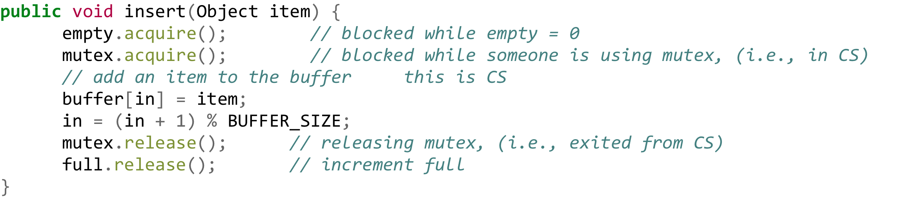
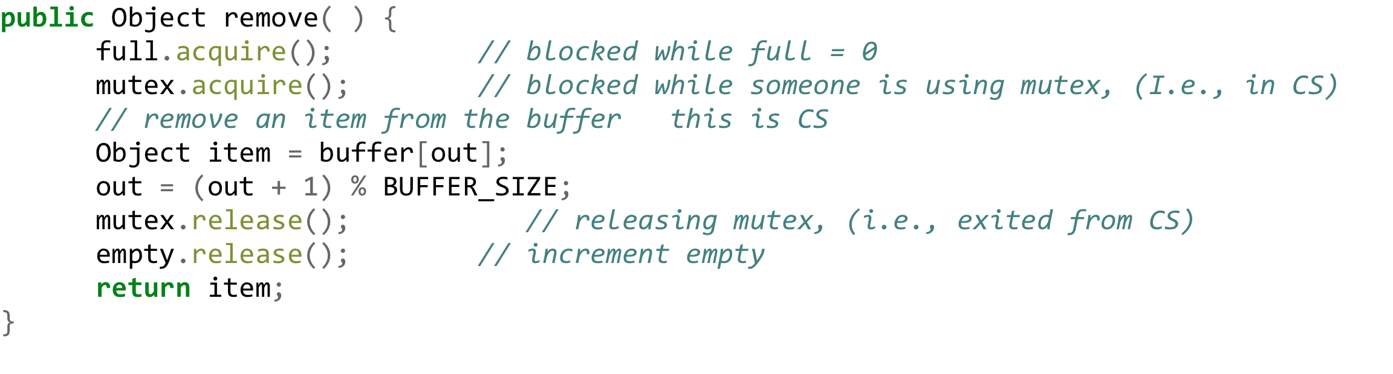
Insert and Remove Methods
Lock
Unlock
1
Lock
Unlock
1

Slide 38
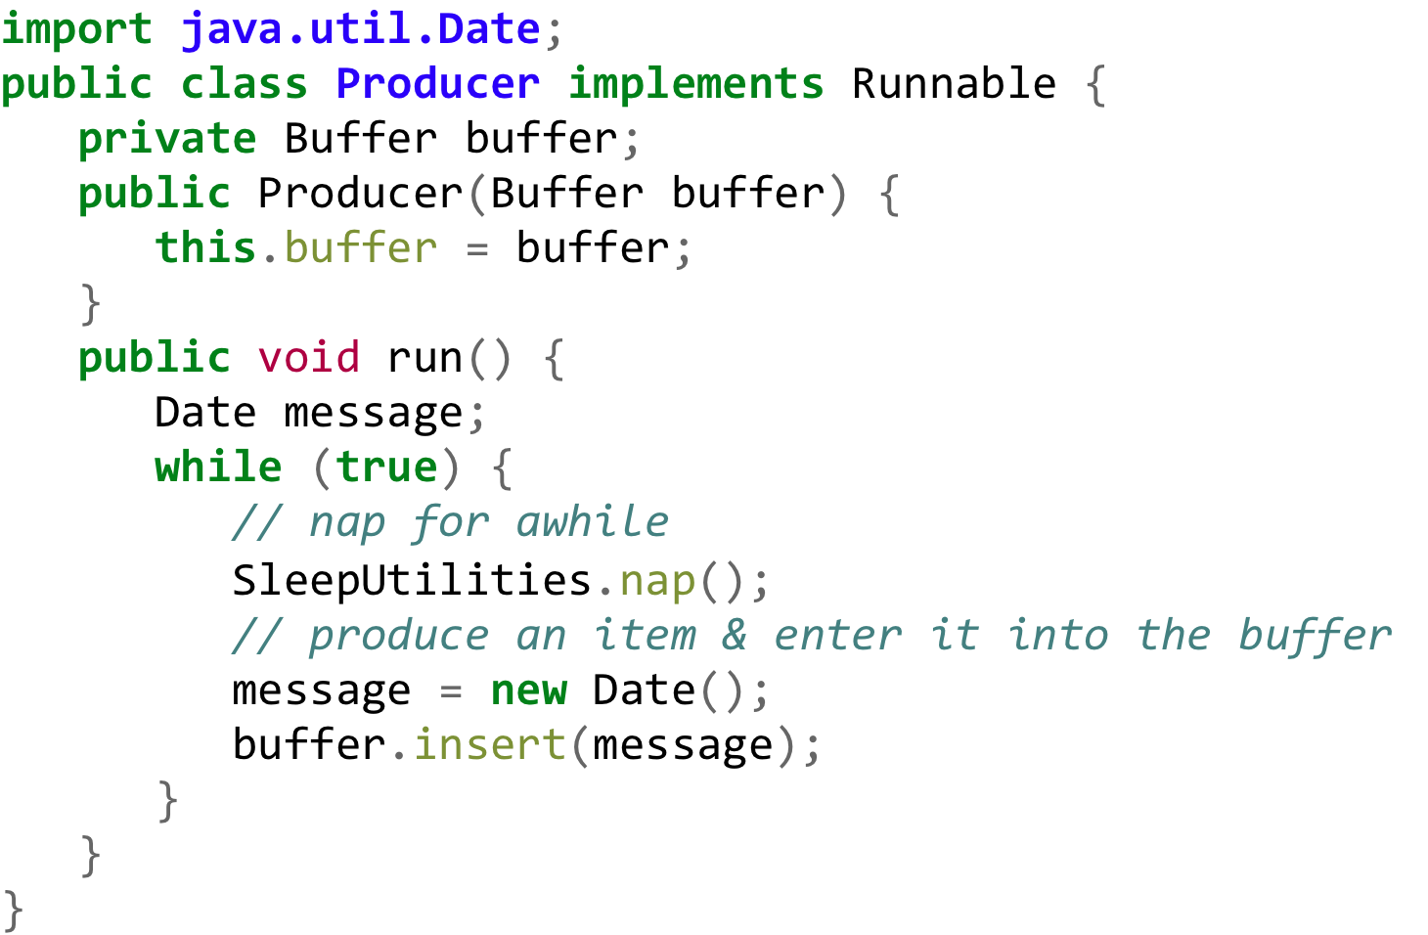
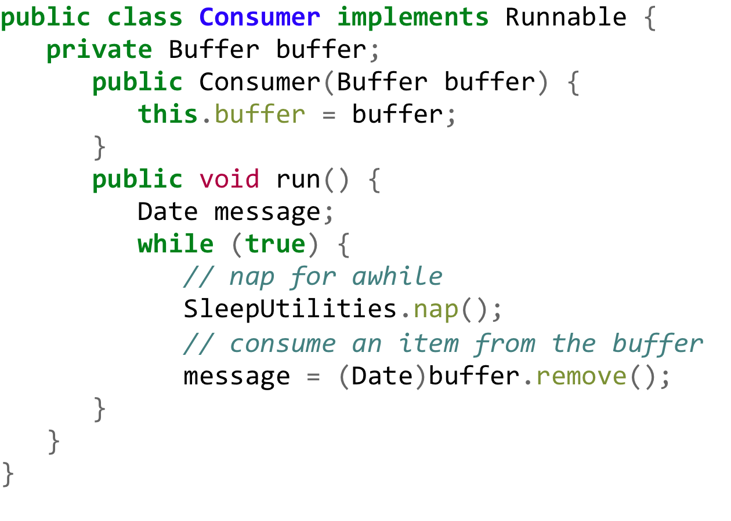
Producer and Consumer Threads
buffer

Slide 39
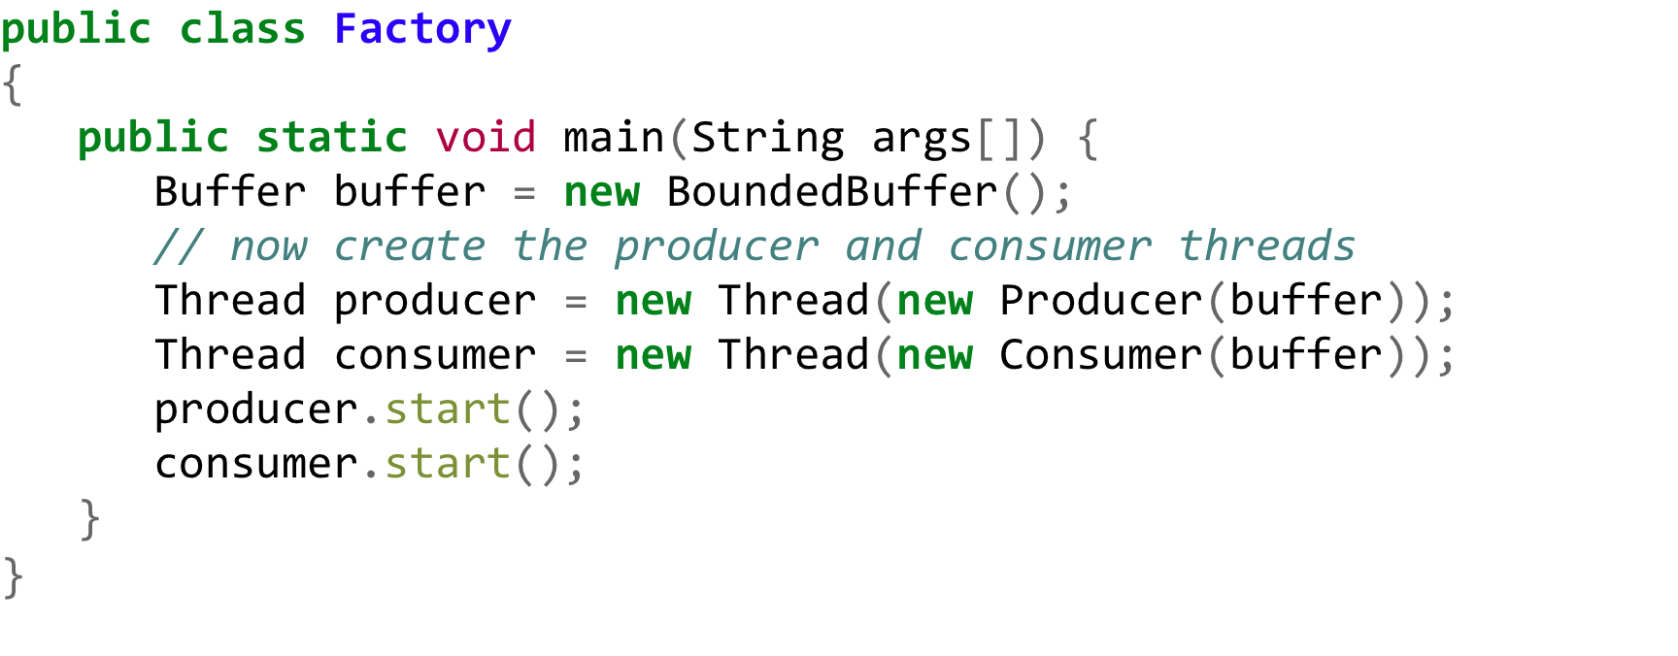
Bounded Buffer Problem: Factory

Slide 40
Concurrent Programming
“Programming concurrent applications is a difficult and error-prone undertaking” – Dietel**
When thread synchronization is required use the following guidelines (in order of complexity):
Use existing classes from the Java API (e.g. import java.util.concurrent.*)
Use synchronized keyword and Object methods wait, notify and notifyAll
Use Lock and Condition interfaces
** (p.678) Java for Programmers, Deitel & Deitel, 2nd Edition, Prentice Hall, 2011

Slide 41
Java Thread Model
New
acquire lock, interrupt,
I/O completes
runnable
notify
notifyAll
enter synchronized
statement
wait
sleep
Interval expires
Notify
notifyAll
task completes
wait
issue I/O request
waiting
timed waiting
terminated
blocked

Slide 42
Monitors
Entry queue
p8
p6
p7
X:
Y:
p2
p4
p1
High-level language construct
Only one process allowed in a monitor, thus executing its method
A process in the monitor can wait on a condition variable, say x, thus relinquishing the monitor and allowing another process to enter
A process can signal another process waiting on a condition variable (on x).
A process signaling another process should exit from the monitor, because the signal process may have begun to work in the monitor.
p3
p5
MethodA
MethodB
MethodC
x.wait( );
x.signal( )
p1
“…the happens-before relationship. This relationship is simply a guarantee that memory writes by one specific statement are visible to another specific statement. “

Slide 43
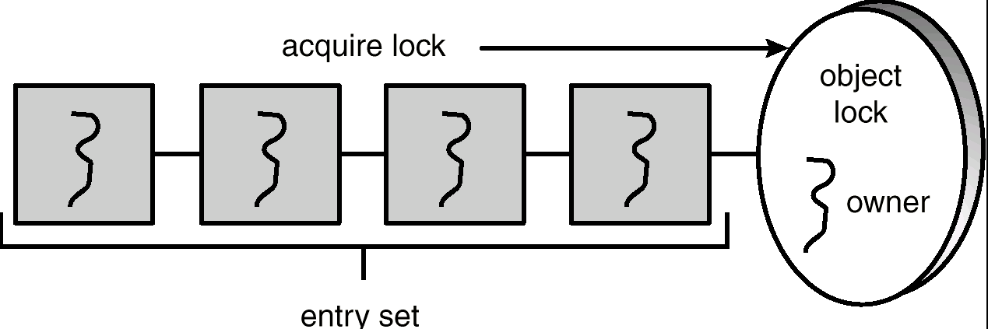
Java Synchronization
intrinsic lock = monitor lock
JavaSE Reference on Synchronization (PLEASE READ IN DETAIL!)

Slide 44
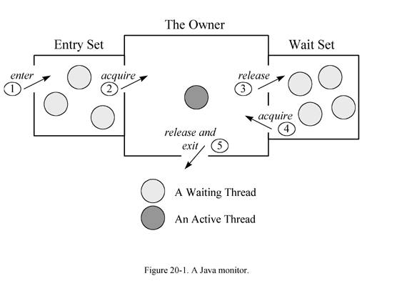
Java Monitor

Slide 45
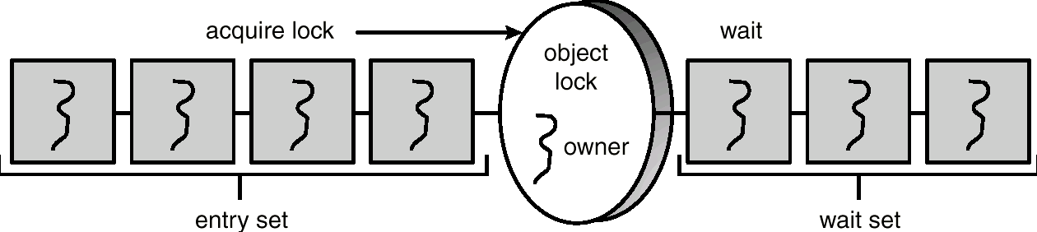
Java Monitor - synchronized method
Every object has an intrinsic lock associated with it.
Calling a synchronized method requires ”owning” the lock.

Slide 46
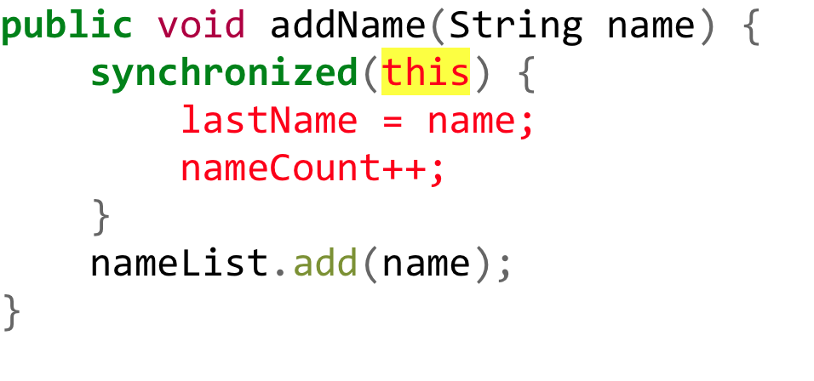
Statement vs. Method Sync
Another way to create synchronized code is with synchronized statements.
Synchronized statements must specify the object (i.e. "this") that provides the intrinsic lock:
To make a method synchronized, simply add the synchronized keyword to its declaration:

Slide 47
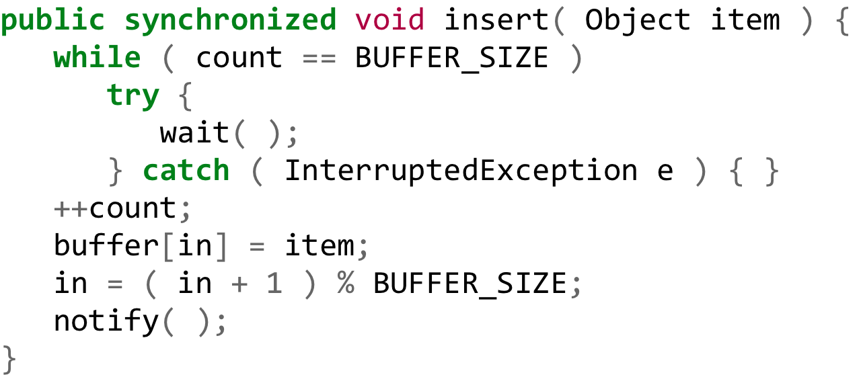
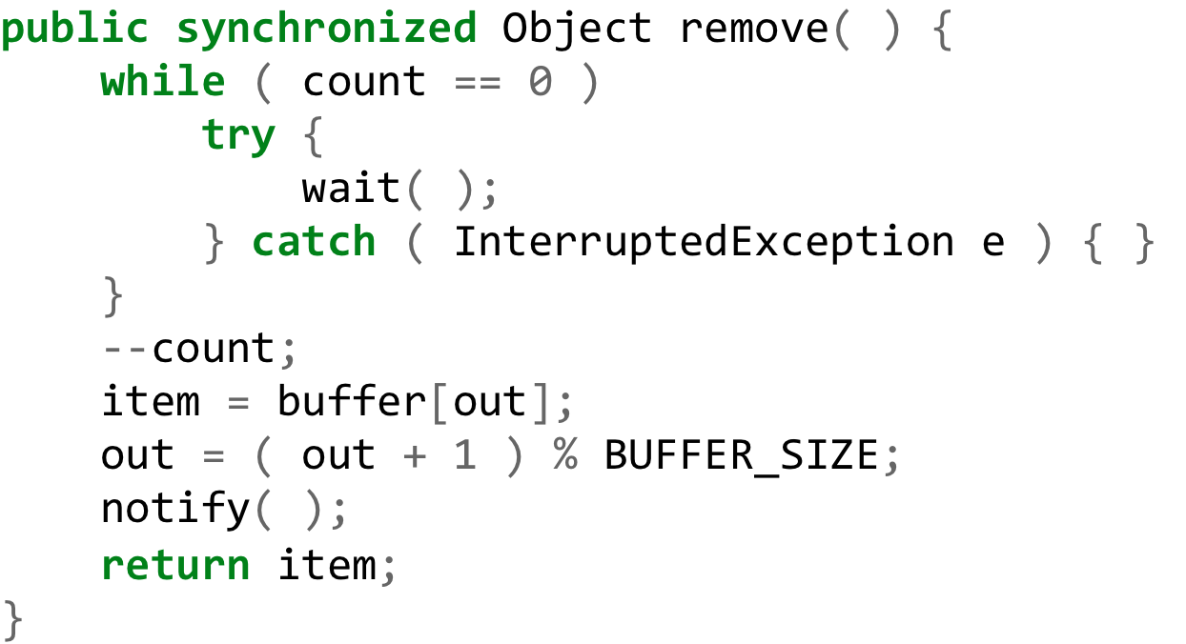
Insert and Remove with Java Synchronization (i.e. Monitors)
Producer
Consumer
CS

Slide 48
Classical Problem 2: The Readers-Writers Problem
Multiple readers or a single writer can use DB.
X
writer
X
X
reader
writer
reader
reader
writer
reader
reader
reader
writer
reader
reader

Slide 49
Database

Slide 50
Readers

Slide 51
Writers
Why do we have to use notifyAll rather than notify?
Is this algorithm perfect?

Slide 52
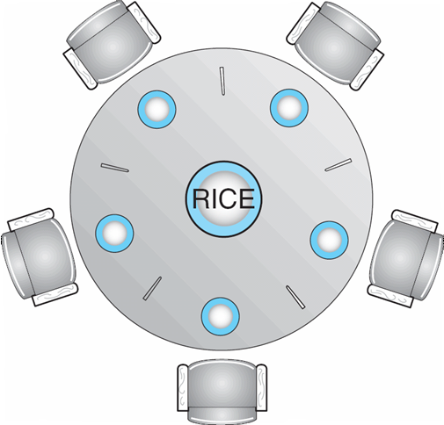
Classical Problem 3: Dining Philosophers Problem
THINKING
HUNGRY
EATING
Shared data
Semaphore chopStick[] = new Semaphore[5];

Slide 53
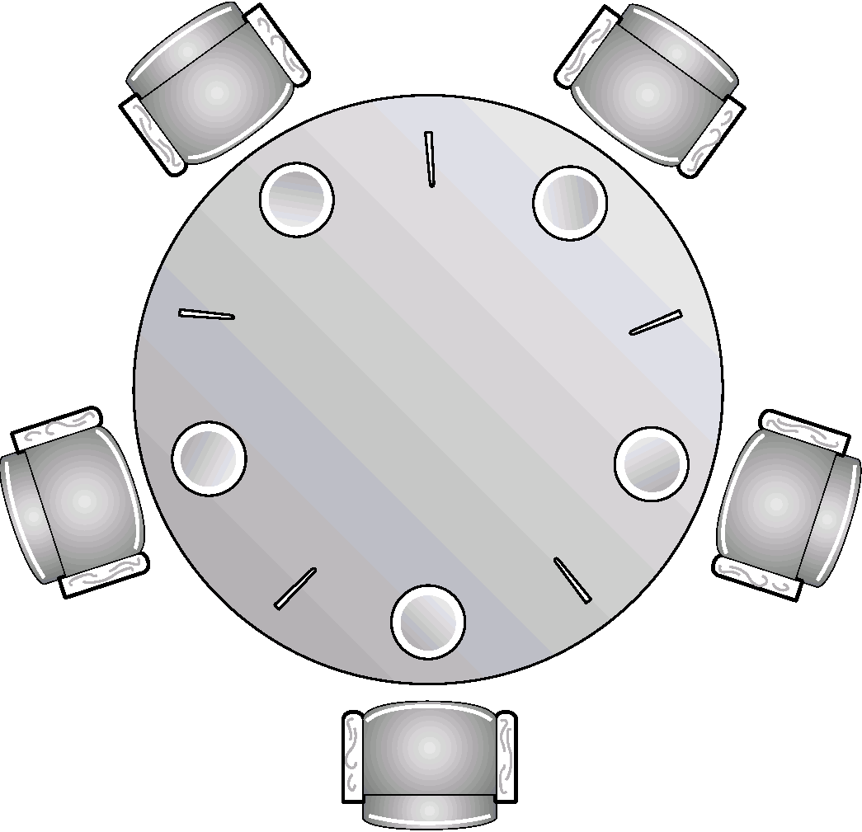
The Structure of Philosopher i
A deadlock occurs!

Slide 54
Dining-Philosophers Problem Using a Monitor (intrinsic lock)
Monitors (Deprecated)
JavaSE : Monitor
URL: java-concurrency-part-5-monitors-locks-and-conditions

Slide 55
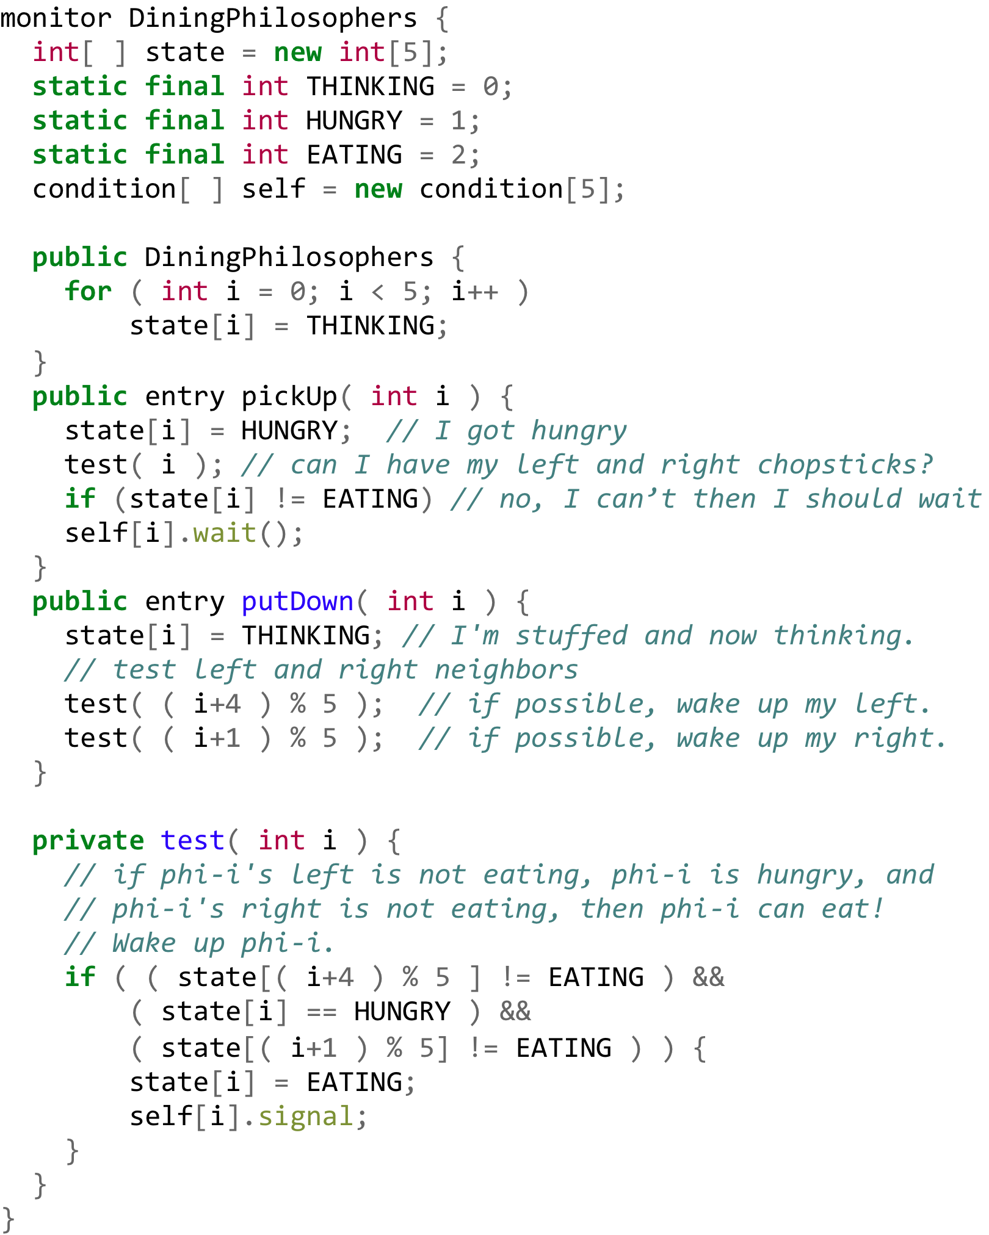
Dining-Philosophers Problem Using a Monitor (intrinsic lock)
Java monitor has only one condition.
Thus, this abstract code must be modified.
Monitors (Deprecated)
JavaSE : Monitor
URL: monitors-locks-and-conditions

Slide 56
Transactional Memory and Concurrency Control
Transactional Memory
Concurrency Control
update ( ) {
atomic {
/* read and write shared data */
}
}
CPU A
CPU B
CPU C
CPU D
Trans_start
TBD
Compare reads with
former writes
R1
R2
W3
R4
W5
Trans_start
R1
R2
W6
R4
W7
Compiler-generated code
Trans_start
validation
R1
R2
W9
R4
W8
update ( ) {
acquire( );
/* read and write shared data */
release( );
}
Commitment
Trans_start
Trans_end
R1
R2
R6
R8
W8
Trans_end
Trans_end
Trans_abort
Trans_restart

Slide 57
Discussions 2
1. Is the solution on slides 48–52 perfect for the readers-writers problem? If not, how can you improve it?
2. Rather than a monitor, there is the simplest way that addresses the dining-philosophers problem but introduces another problem. What is that?
3. If we want to handle multiple monitor conditions in Java, what classes should you design?

Slide 58
Exercises
Programming Assignment 3:
Check the syllabus for its due date.
No-turn-in problems:
Solve Exercises 6.8, 6.12, 6.13, 6.14, 6.19, and 6.24

Slide 59
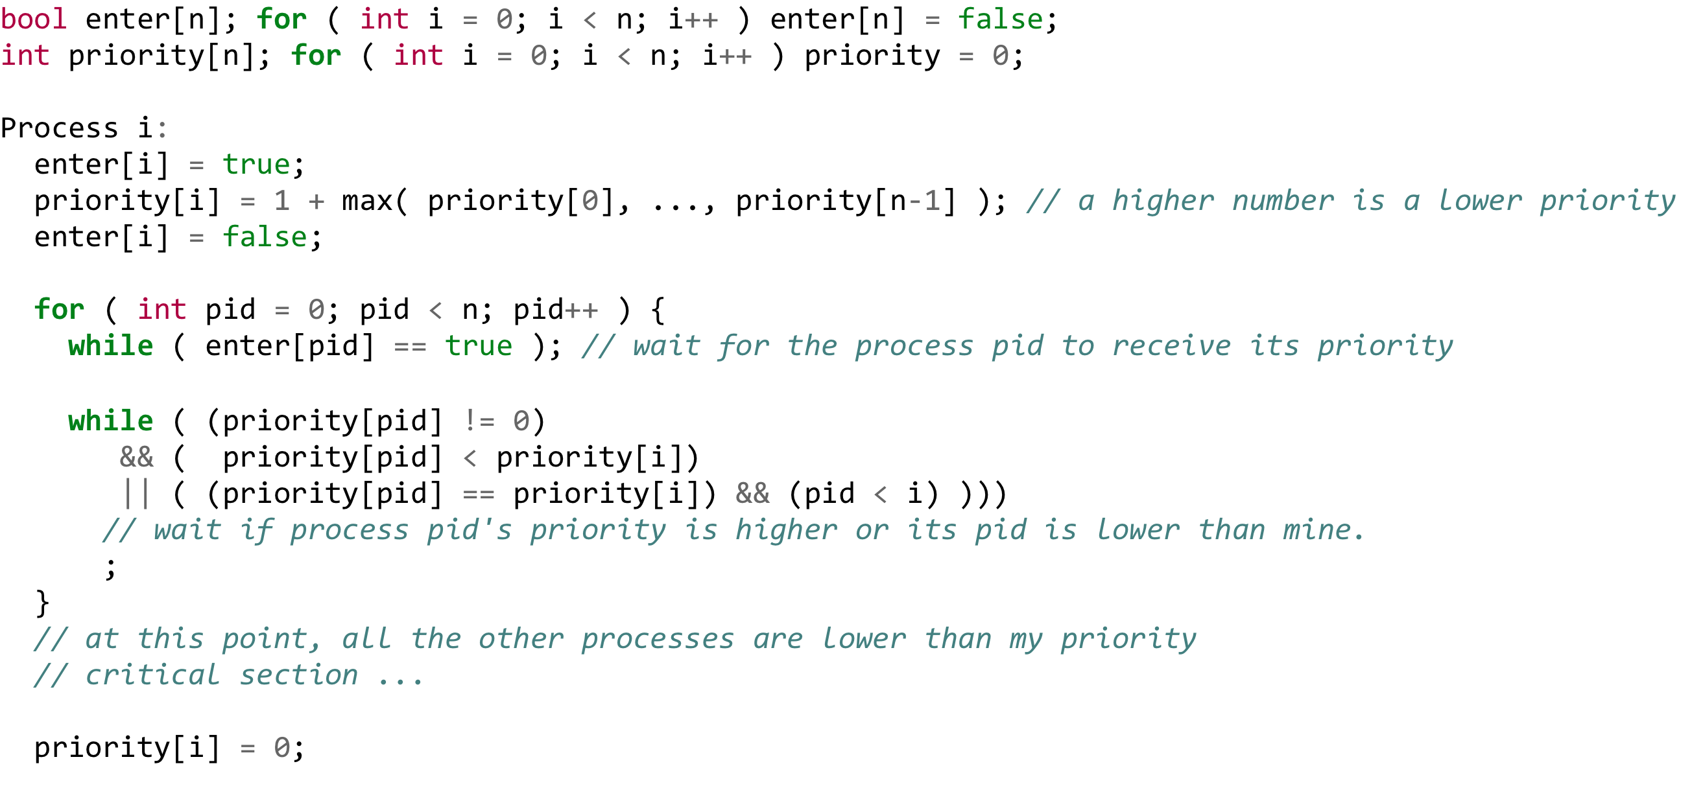
Appendix - Lamport’s Algorithm
Lamport's bakery algorithm (wikipedia)
Lamport’s additional remarks
Leslie Lamport’s 1974 Original Paper

